Slide 1
Online Fee
Payment System

Slide 2
Introduction :
Online fee payment system provides sophisticated and secure payment solution for educational institutions to collect and manage fee transactions.
It also helps students to pay their college fees and exam fees without visiting college.
It helps for management to pay salary for staff through online.
The main advantage for management is they can keep track about all bank transaction about staff salary and student fees.

Slide 3
Existing System :
User has to carry out each process manually for making college/exam fees payment.
In case of exam fee he/she has to take exam form fill manually .
Student has to submit all the documents xerox and paste a photo on exam form.
It is overhead for the staff to collect and maintain student details.

Slide 4
Disadvantages :
It is time consuming.
Retrieval of data takes lot of time.
It creates lot disturbances in college campus.
Student can miss the class by giving reason of fee payment.

Slide 5
Proposed System :
Online fee payment system, for students to make fee payment online.
Many payment methods are provided to make payment.
Admin can see all transaction in one view.
Admin can see the fee status of students and pay staff salary.

Slide 6
Features :
To provide huge maintenance of records.
Flexibility of transaction can be completed on time.
To provide easy and secure payment for exam and college fee.
To provide easy reference for staff and students.

Slide 7
Modules :
Admin module
User (students) module.

Slide 8
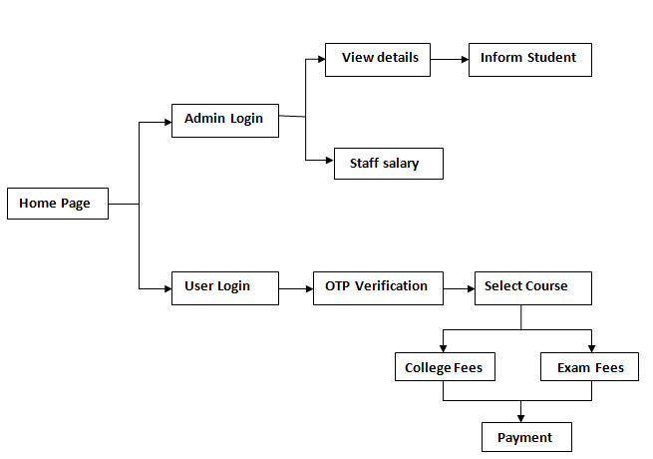
System Architecture:

Slide 9
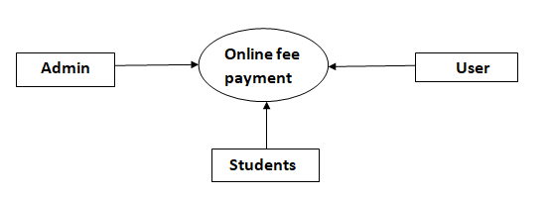
Data Flow Diagram:

Slide 10
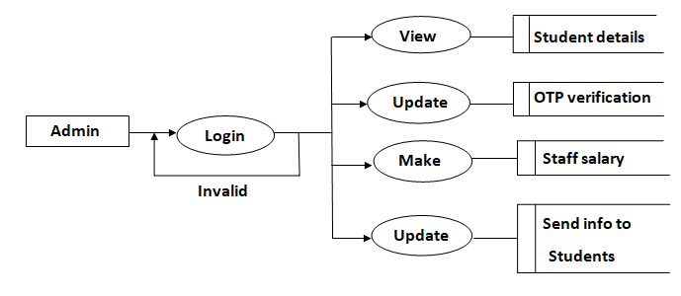
Admin:

Slide 11
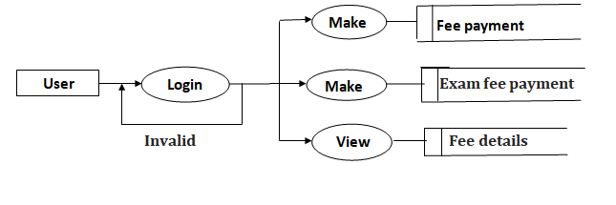
User(Students):

Slide 12
System Requirements:
Software Requirements:
Front End : HTML
Back End : MYSQL
Server : Xampp , Wamp
Browser : Google chrome, Internet Explorer
Hardware Requirements:
Operating System : Windows
Processor : Intel core i3
RAM : 4GB
Hard Disk : 120GB and above
System Bus : 64bits

Slide 13
Conclusion :
The conclusion, this project is to provide user to make "Online Payment" of college/exam fees.
Admin can see all the transaction related to college fees, exam fees and staff salary in one view.
Advantage is we have not fixed amount to be paid user can pay the fees in instalment.
Admin can easily get student list who have not paid fees.
It is easy for admin to send message/inform the students to make payment on time.

Slide 14
Thank you

